Slide 1
Backtracking Algorithm Implementation for Sudoku Solver
Jonathan Dervin, Roman Higginson, Zaryaab Qasmi

Slide 2
Abstract
Objective: Enhancing Understanding of Backtracking Algorithms and AI
Implementation: Focus on Backtracking Algorithm for Efficient Sudoku Puzzle Solving
Incorporation of Strategic Methods to Enhance Algorithm Effectiveness
Insights Gained: Integration of Logical Algorithms for Solution Determination and Optimization of Solution-Seeking Methodologies Using Generative Algorithms

Slide 3
Introduction

Slide 4
Background
Sudoku
A puzzle game that involves the player entering certain numbers from 1 to 9 into a 9x9 grid while being mindful of not violating the rules of the game.
When a player inputs a number, the number must not be the same as another number in the same row, the same column, and the same 3x3 sub-grid.
Solving Strategy Examples
Hidden Singles
Naked Pairs/Triples
Hidden Pairs/Triples.

Slide 5
Problem Statement
The backtracking algorithm addresses are the rules that this game abides by. The fact that each number in each row, column, and sub-grid must be unique.

Slide 6
Objective
The goal was to use several solving strategies to solving 5 boards. But when none of the solving strategies can be used, the program will resort to using the backtracking algorithm to solve them.

Slide 7
Methodology

Slide 8
Algorithm Overview
A Sudoku Board is considered to be a Constraint Satisfaction Problem (CSP):
A problem where we need to assign a set of variables that satisfy all of the restrictions given. The backtracking algorithm is a searching algorithm for CSPs where we use a search tree to assign a single variable per level.
Key Components of a CSP:
Variables: These represent every cell inside the Sudoku board
Domains: These represent a list of numbers that each cell can have.
Constraints: These represent the limitations each value in the cell must follow.
The backtracking algorithm is meant to assign a number from a domain to an empty cell while being consistent to the constraints of the Sudoku board. If the cell is not consistent, unassign the cell and go to the next number in the domain. If the cell is consistent, go to the next empty cell. If no number in the cell’s domain is consistent to the constraint, backtrack to the last cell that was assigned.

Slide 9
Algorithm Overview
Backtracking Algorithm Logic
Assign a number from a domain to an empty cell while being consistent to the constraints of the Sudoku board.
If the cell is not consistent, unassign the cell and go to the next number in the domain. If the cell is consistent, go to the next empty cell.
If no number in the cell’s domain is consistent to the constraint, backtrack to the last cell that was assigned.

Slide 10
Client-Server Application
Front-end Architecture:
Utilization of Bootstrap, HTML, CSS, and JavaScript for constructing an interface.
Two web pages with similar layouts:
Input Page
Solve Page
Implementation of JavaScript's fetch requests for server interaction.

Slide 11
Client-Server Application
Back-end Infrastructure:
Flask framework to establish a server.
Flask routing client requests to distinct functions.
Primary functions:
"serve_html" serves HTML files upon client requests, locating and returning specified files.
"customBoard" enables users to submit Sudoku game boards, initiating solution search..
Auxiliary functions for data transformation into JSON format, facilitating communication between front-end and back-end components.

Slide 12
Implementation Details
The Sudoku Board is represented as its own class, The Board class, which contains instances of the Cell class, which represents a value on the board.
The CSP and its components are represented as a dictionary. The keys of the CSP would be a string named after the components: variables, domains, and constraints.
The value of the variable key would have a list variable containing the cells of the Sudoku Board.
The value of the domain key would contain a dictionary of each variable containing a list of numbers from 1 to 9.
The value of the constraint key would be a dictionary of each constraint type: rows, columns and sub-grids. Each constraint holds a lambda function for checking if a given value violates the constraint or not.

Slide 13
Implementation Details
We use a class called solve_sudoku_csp that takes the current board and the CSP variable as parameters. The solve_sudoku_csp class contains three functions:
First function is the backtracking function
Second function is for checking for available empty cells in the board
Third function is for checking if the recently assigned board is consistent with the constraints.

Slide 14
Results

Slide 15
Performance Analysis
It solved all five puzzles using the backtracking algorithm.
Each puzzle was tested 5 times to calculate the average time each one took to solve.

Slide 16
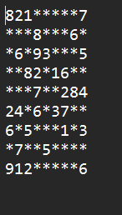
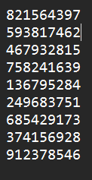
Puzzle 1
Number of Backtracks: 1516
Times
Run 1: 44.6 ms
Run 2: 60.5 ms
Run 3: 49.2 ms
Run 4: 47.2 ms
Run 5: 45.8 ms
Average Time: 49.5 ms

Slide 17
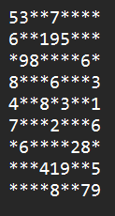
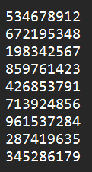
Puzzle 2
Number of Backtracks: 4209
Times
Run 1: 112 ms
Run 2: 116 ms
Run 3: 109 ms
Run 4: 115 ms
Run 5: 116 ms
Average Time: 113.6 ms

Slide 18
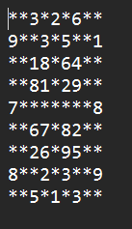
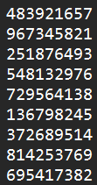
Puzzle 3
Number of Backtracks: 201
Times
Run 1: 15.1 ms
Run 2: 13 ms
Run 3: 11.8 ms
Run 4: 11.3 ms
Run 5: 12.6 ms
Average Time: 12.8 ms

Slide 19
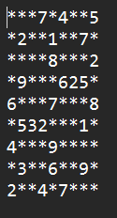
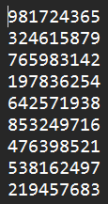
Puzzle 4
Number of Backtracks: 70373
Times
Run 1: 1.79 s
Run 2: 1.79 s
Run 3: 1.8 s
Run 4: 1.81 s
Run 5: 1.8 s
Average Time: 1.8 s

Slide 20
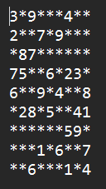
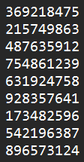
Puzzle 5
Number of Backtracks: 1525
Times
Run 1: 44 ms
Run 2: 42.8 ms
Run 3: 43 ms
Run 4: 42.7 ms
Run 5: 46.1 ms
Average Time: 43.7 ms

Slide 21
Discussion

Slide 22
Efficiency Evaluation
Time Complexity:
O(k^{n})
Space Complexity:
O(k^{n})
k being how many times the function recursively calls itself and n being the number of empty cells on the board.

Slide 23
Limitations
Exclusion of Complex Strategies:
Some solving strategies are overly complex, posing risk of increased solving time.
Effectiveness:
Not all strategies may be effective for all puzzles.
Backtracking Algorithm Workload:
Despite employed strategies, backtracking algorithm remains primary workload carrier.

Slide 24
Conclusion

Slide 25
Summary of Findings
We found that the backtracking algorithm was very effective in solving multiple Sudoku boards.
Though, depending on the difficulty of the board, the amount of time it takes to solve it can very, showcasing how the backtracking algorithm at its core is a brute force approach to problem solving.

Slide 26
Recommendations
Display:
Refinement of webpages.
Strengthening client-server connection.
Solver:
Incorporation of additional solving strategies.
Integration:
Implementation of mechanism to determine optimal transition point between different solving methods for increased efficiency and effectiveness.

Slide 27
References
Backtracking. Interviews.school. (n.d.). https://interviews.school/backtracking
GeeksforGeeks. (2023, October 16). Introduction to backtracking - data structure and algorithm tutorials. https://www.geeksforgeeks.org/introduction-to-backtracking-data-structure-and-algorithm-tutorials/
Gupta, U. (2024, March 26). Recursion & Backtracking Time Complexity. Code 360 by coding ninjas. https://www.naukri.com/code360/library/recursion-backtracking-time-complexity
Stuart, A. (2005a, May 28). Sudoku solver by Andrew Stuart. https://www.sudokuwiki.org/sudoku.htm
Stuart, A. (2005b, June 9). Naked candidates. SudokuWiki.org - Naked Candidates. https://www.sudokuwiki.org/Naked_Candidates#NP
Stuart, A. (2008, April 9). Hidden candidates. SudokuWiki.org - Hidden Candidates. https://www.sudokuwiki.org/Hidden_Candidates#HP

